Slide 1
Demo Day
Cameron, Sam, Lio, Ray, Diogo and Jose

Slide 2
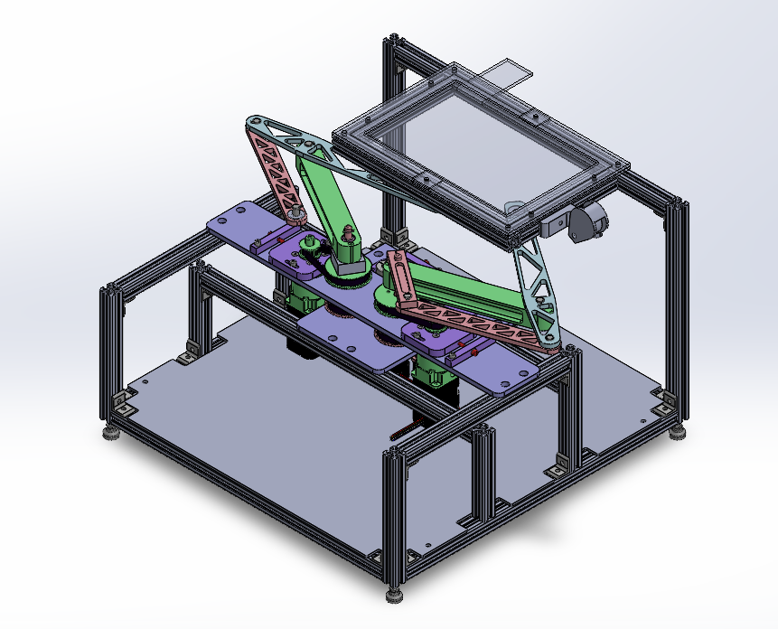
Design Requirements
Transversable area of 7” x 10”
Continuous 6N possible at the end effector
Moving speed up to 150 mm/s
Virtual wall stiffness of 1N/mm
Descoped for Alpha
Track two points of contact -> one point of contact
One rotation of points, distance between points, etc.

Slide 3
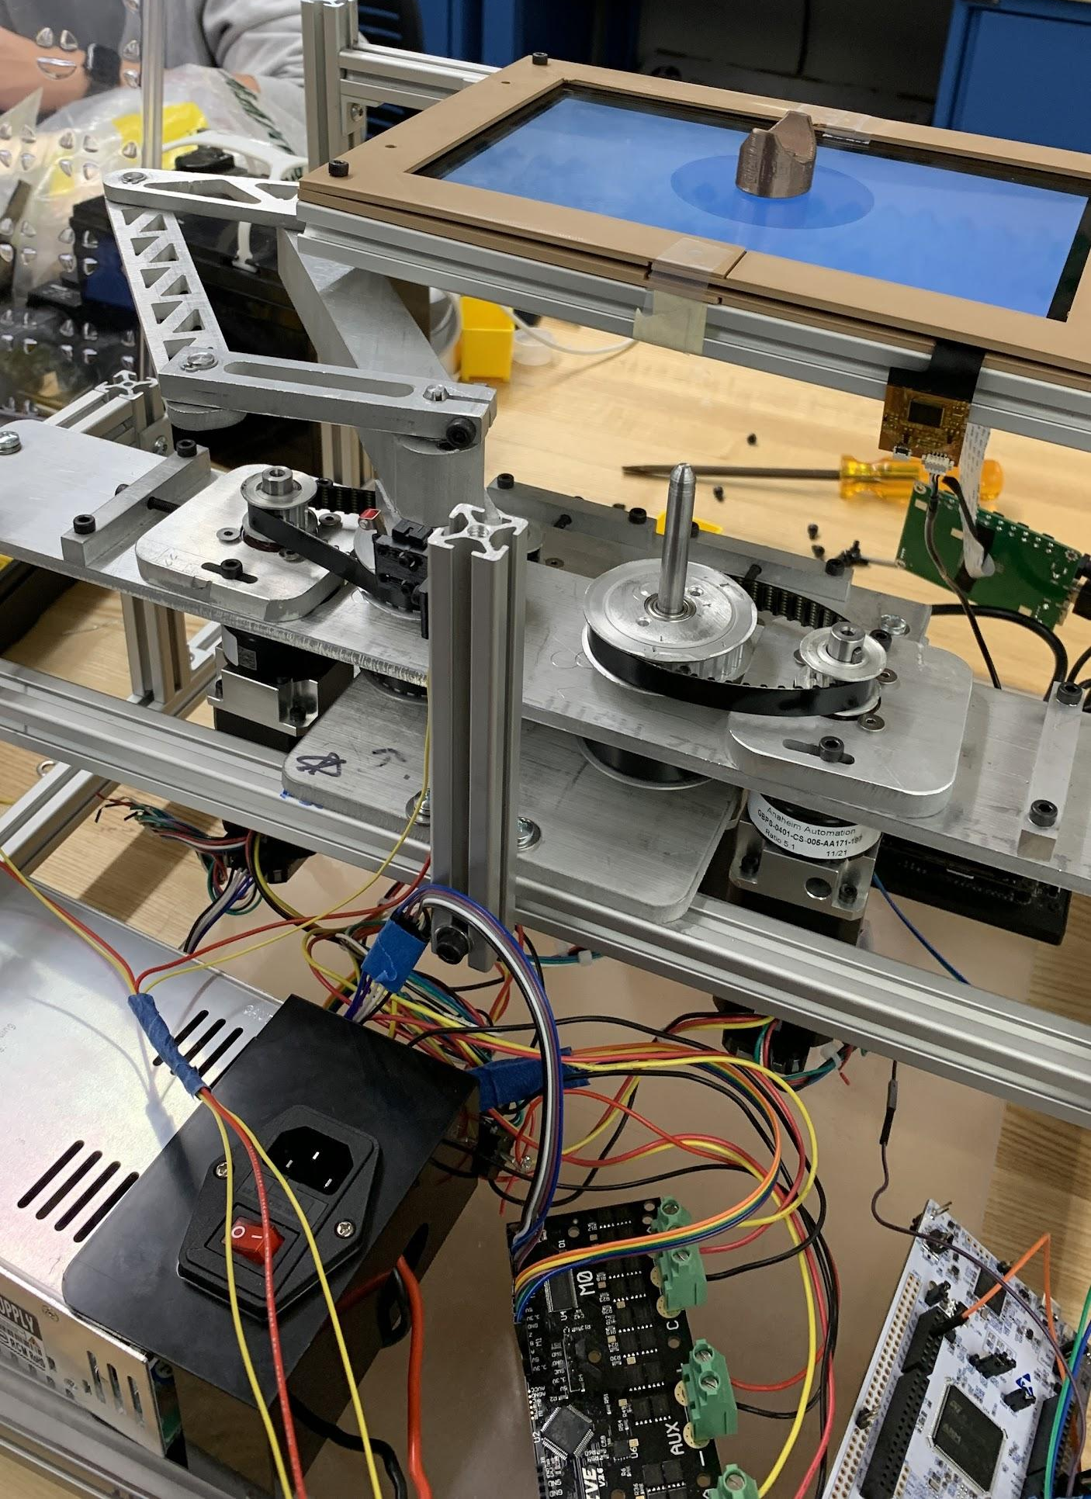
Mechanical - Alpha
Revised design
Removed upside-down motor
Updated link design to improve stiffness
Refined stack on longer shaft
Add limit switches
Waterjet and machined all custom components
Fully-assembled left-half linkage and 8020 frame
Mounted key components to 8020 Frame

Slide 4
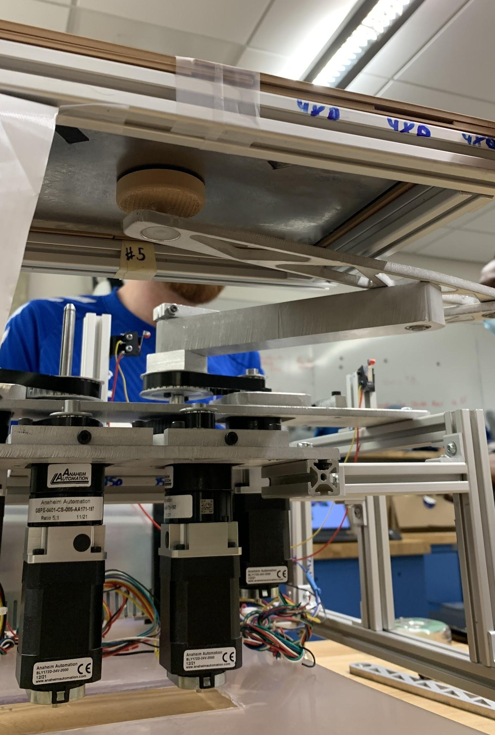
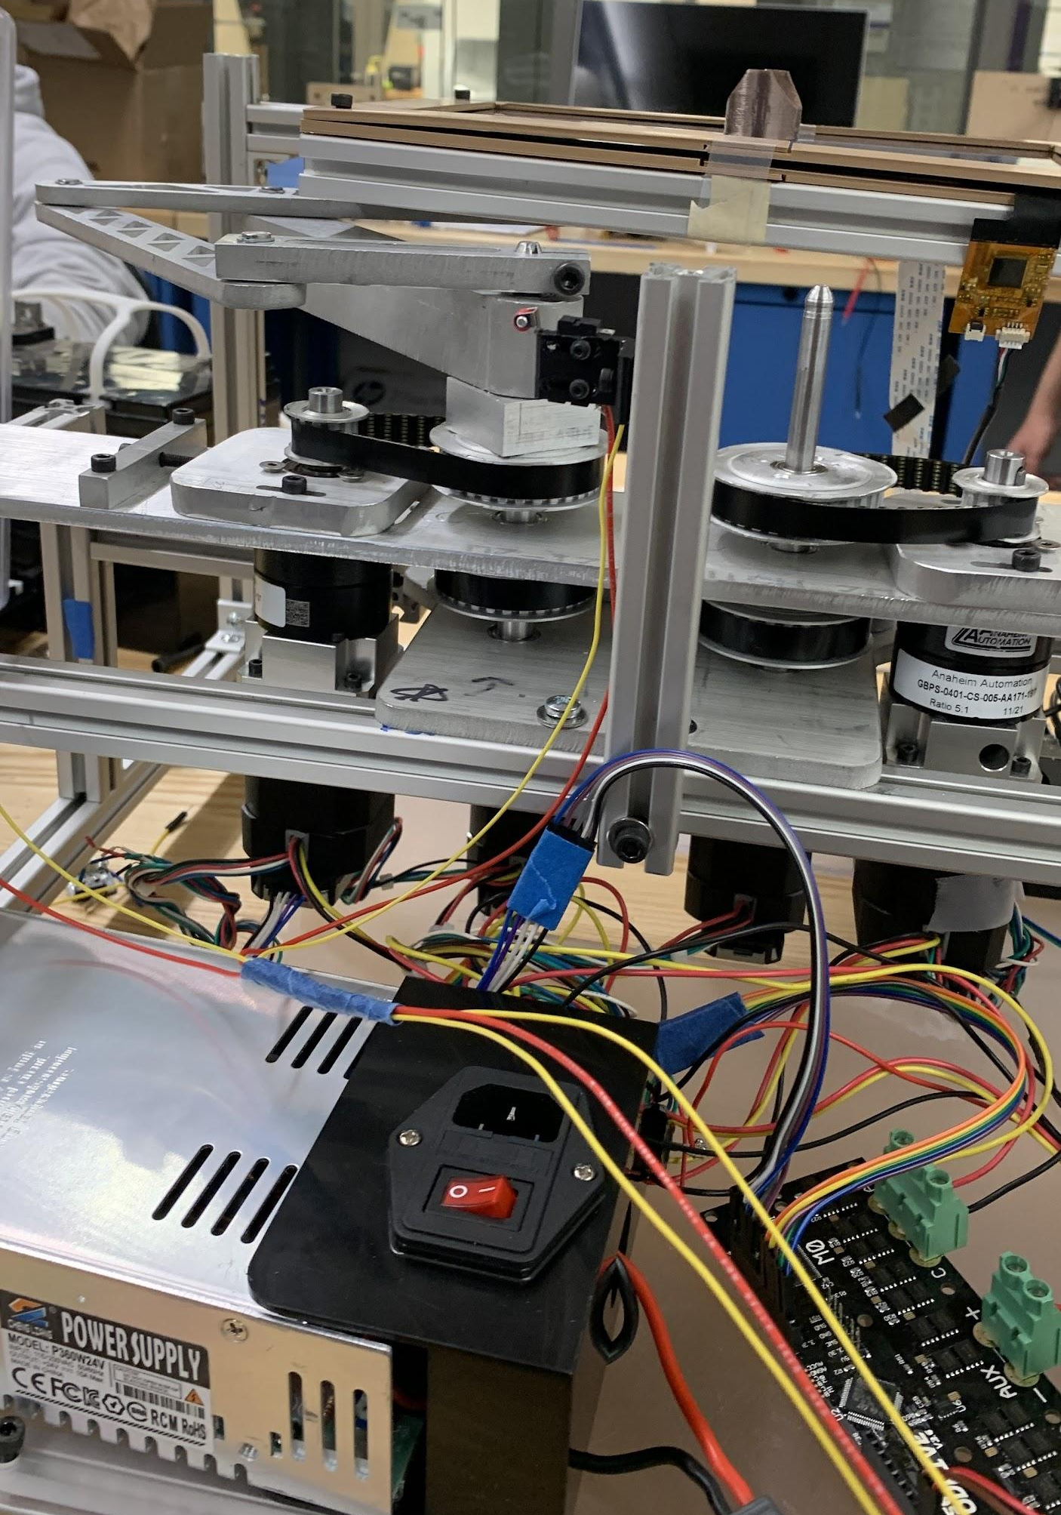
Mechanical - Beta
Improve backdrivability
Analyze rotating components for ways to improve alignment & smoothness
Improve stiffness in the frame via gussets
Improve wire management
Add acrylic guards to remove pinch points

Slide 5
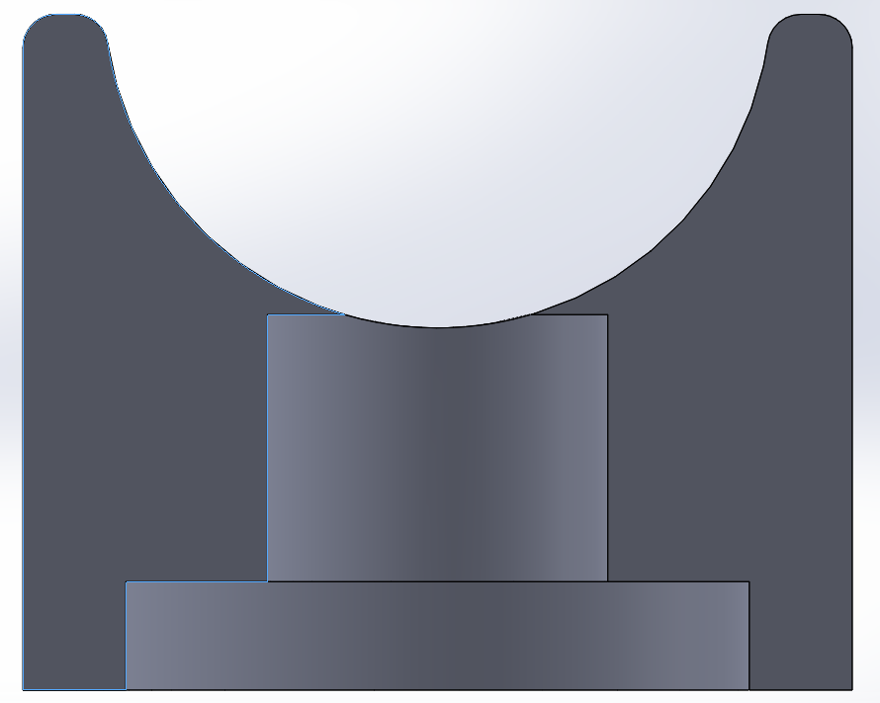
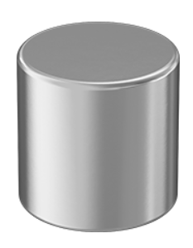
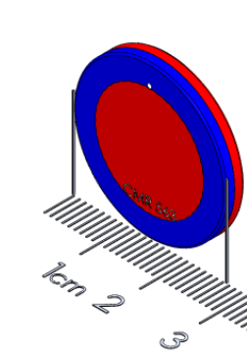
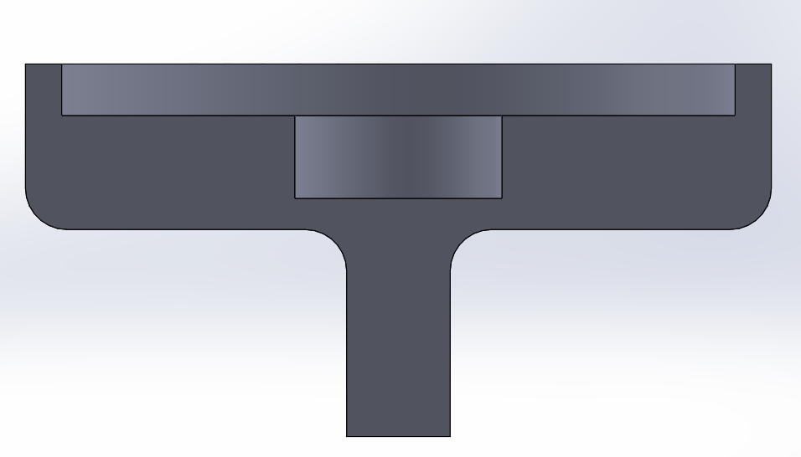
Magnet
New selection of magnets to increase shear force (8 N), while sustaining normal force and low friction (4 N)
New puck design to allow for direct grounding
Notes:
McMaster Magnet: 18N normal force
Polymagnet Magnet: 13.1N normal force
0.1N Shear force

Slide 6
Electronics
Phase ABC
Phase ABC
Axis0
Axis1
Touchscreen
Motor
Gearbox
Motor
Gearbox
GND
FFC
FFC
Touch
sensor
HDMI
Driver
Power
Odrive
Encoder
Encoder
3.3V GND A B Z
USB
HDMI
3.3V GND A B Z
TX
RX
Nvidia
Power
RX
TX
Power Supply
GND
STM32
TX
GND
RX

Slide 7
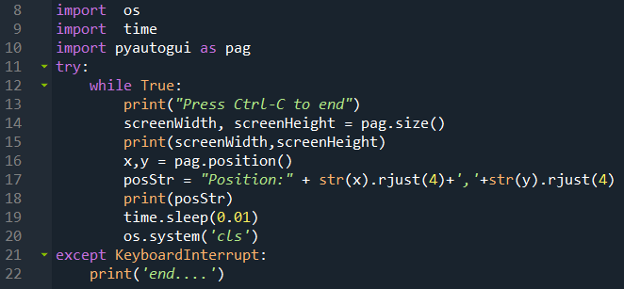
Electronics

Slide 8
Embedded
Screen (u, v) pix Touch module
Screen (x, y) mm Resolution calculation
Top Magnet (x, y)mm – –
Button Magnet desired force (Fx, Fy) N Algorithm (e.g. stiff wall)
Button Magnet desired pos (x, y) mm Magnet (displacement - force) relationship
Arm EE(x, y)mm – –
Arm Angle(theta1, theta2) revolution IK solver

Slide 9
Embedded
Basic Calibration
Using switch to get the absolute angle (incremental encoder)
Use Geometric relationship to calculate the screen arm transformation
Full Automatic Calibration – TBD
Let Motor be IDEL User move the Top Magnet
Read (u, v) and Arm angle (theta1 theta2)
Use multi Group data to solve all the unknown parameter.

Slide 10
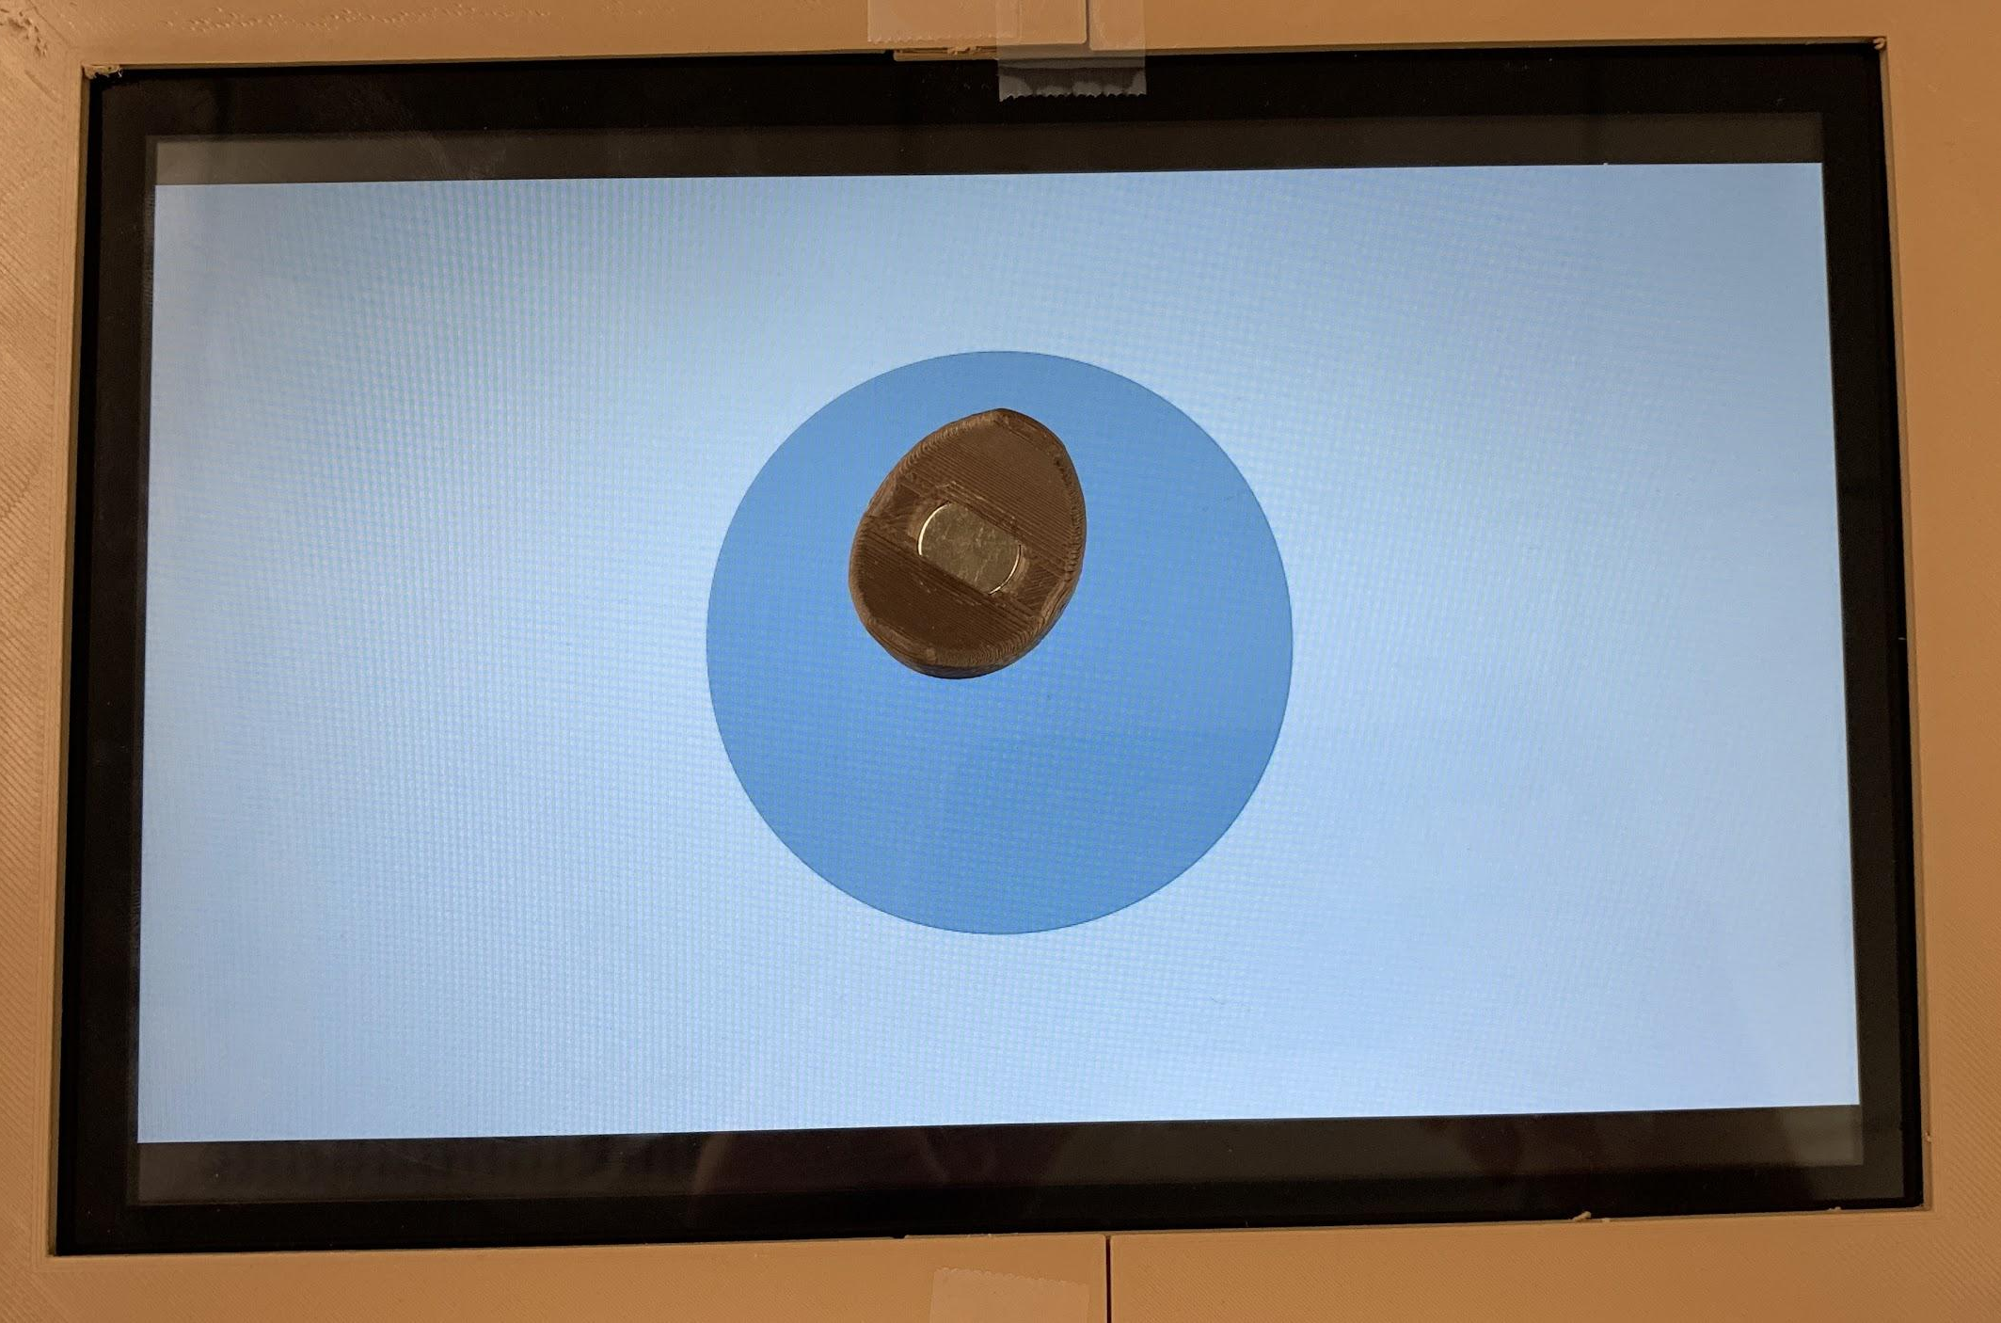
Demo!
Single-point tracking
Circular virtual wall

